Slide 1


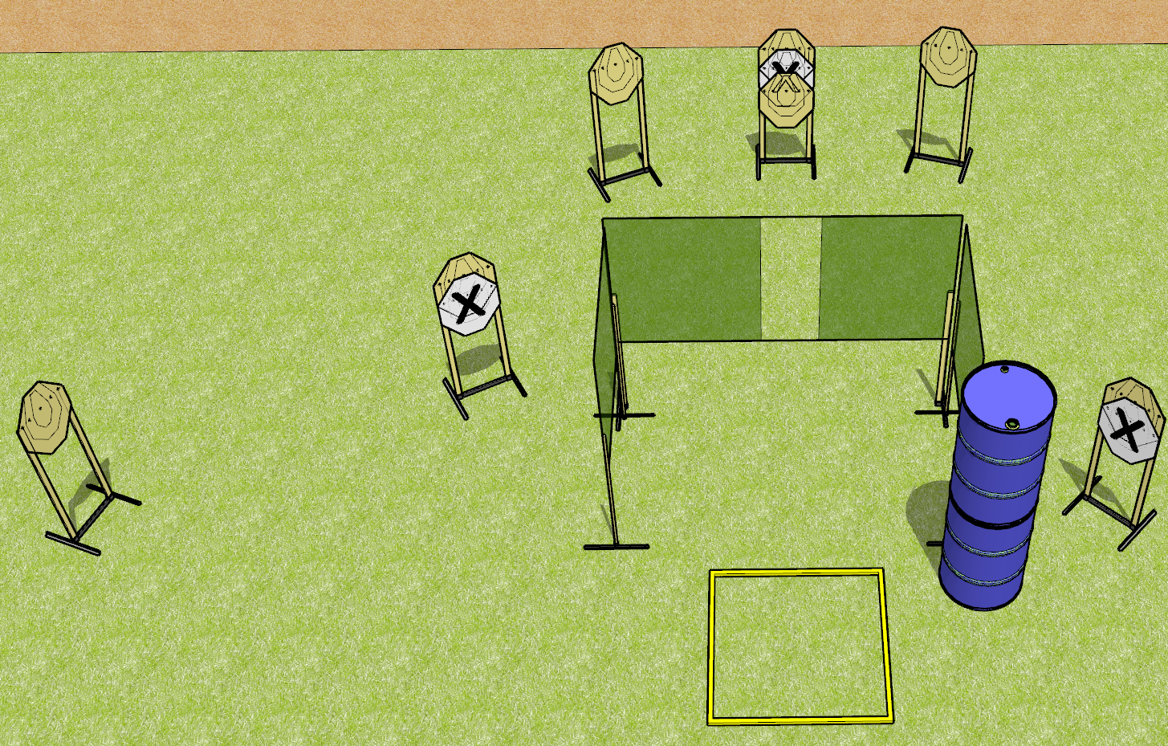
 | Dothan Gun Club – USPSA Match Down With the Quickness Course Designer : Drew Coleman
Round Count 14 rounds 7 IPSC
Equipment List 1 outer limits box 4 wall feet

Slide 2
Down With the Quickness
Written Stage Briefing
Down With the Quickness is a 14 round, 70 point, Comstock course of fire. There are 7 IPSC targets. The best 2 hits on paper will score. The start signal is audible.
Handgun start position is feet touching the shooting box, wrists below belt. Handgun is loaded and holstered.
PCC start position is feet touching the shooting box. Loaded carbine is held with both hands, stock on belt, safety on.
On start signal, engage targets as they become available from within the shooting area. Do not shoot Dan’s walls.

Slide 3
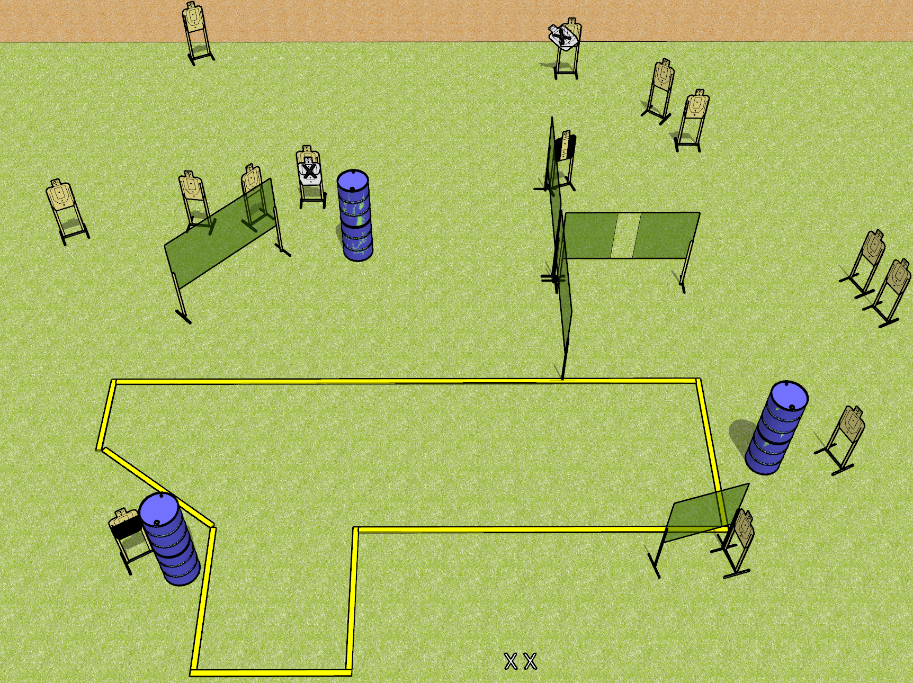
 | Dothan Gun Club – USPSA Match Raygun Course Designer : Drew Coleman
Round Count 28 rounds 14 USPSA targets
Equipment List 11 wall feet 1 action target, 1 headshot, 1 Tuxedo Notes: Barrel in the center is to block shoot through. Upper right – the open target that’s angled inwards should be available from the far left corner of the stage. Consider moving X’s some place more annoying.

Slide 4
Raygun
Written Stage Briefing
Raygun is a 28 round, 140 point, Comstock field course. There are 14 USPSA targets. The best 2 hits on paper will score, and steel must fall to score. The start signal is audible.
Handgun start position is both feet on X’s, wrists below belt. Handgun is loaded and holstered.
PCC start position is both feet on X’s. Loaded carbine is held with both hands, safety on.
On start signal, engage targets as they become available from within the shooting area.

Slide 5
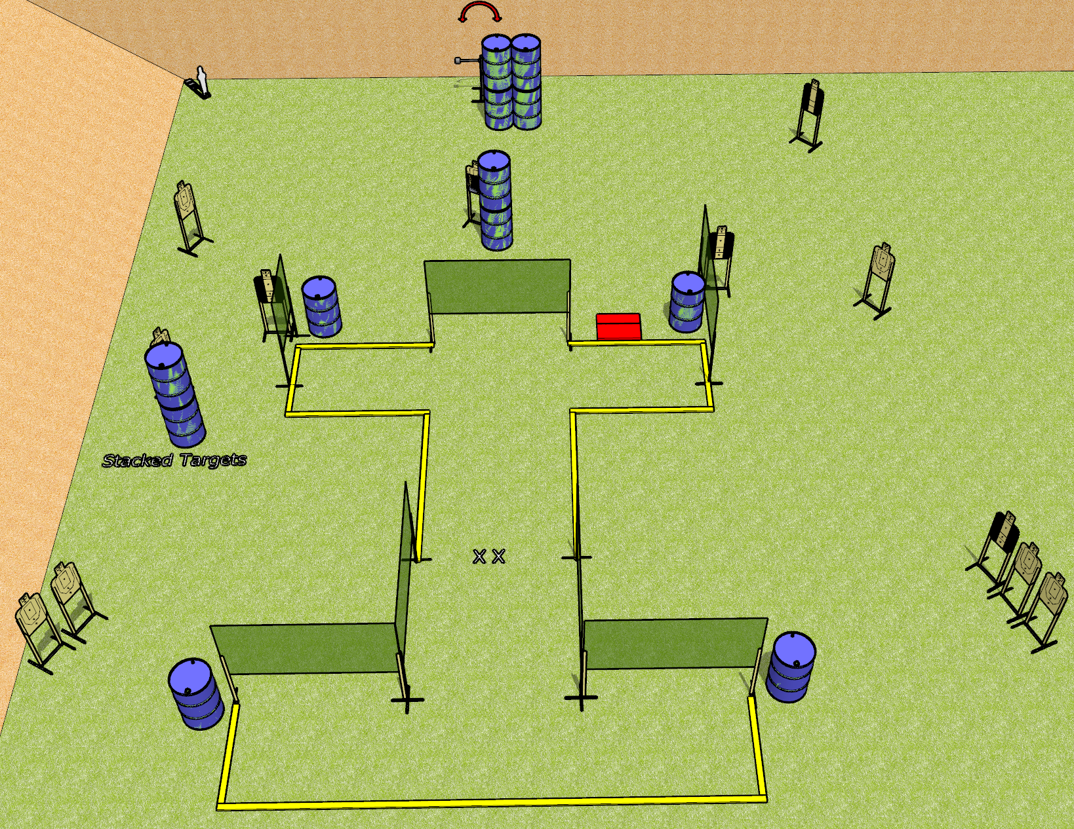
 | Dothan Gun Club – USPSA Match My Mags Are Where? Course Designer : Drew Coleman
Round Count 29 rounds 14 USPSA Targets 1 mini popper
Equipment List 12 wall feet Stomp box + 1 swinger 4 medium fault lines 4 tuxedos, 1 50%

Slide 6
My Mags Are Where?
Written Stage Briefing
My Mags Are Where? is a 29 round, 145 point, Comstock course of fire. There are 14 USPSA targets and 1 mini popper. The best 2 hits on paper will score, and steel must fall to score. The start signal is audible.
The swinger is activated by the stomp box and is visible at rest. Please check the activator prior to walkthrough and set it the same way every time.
Handgun start position is feet on X’s, wrists below belt. Handgun is UNLOADED and holstered.
PCC start position is feet on X’s. UNLOADED carbine is held with both hands.
All magazines to be used during the stage must come from barrels.
On start signal, engage targets as they become available from within the shooting area.

Slide 7
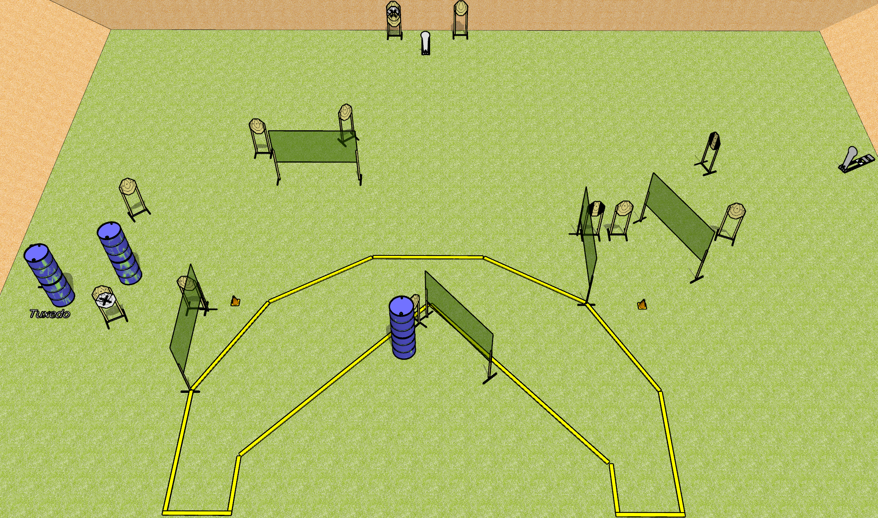
 | Dothan Gun Club – USPSA Match Some Kind of Shoe Course Designer : Drew Coleman
Round Count 30 rounds 14 IPSC 2 colt poppers
Equipment List 10 wall feet 4 medium fault lines 3 hard cover of some kind

Slide 8
Some Kind of Shoe
Written Stage Briefing
Some Kind of Shoe is a 30 round, 150 point, Comstock course of fire. There are 14 IPSC targets and 2 colt poppers. The best 2 hits on paper will score, and steel must fall to score. The start signal is audible.
Handgun start position is heels against either rear fault line, wrists below belt. Handgun is loaded and holstered.
PCC start position is heels against either rear fault line, muzzle pointed at either cone. Loaded carbine is held with both hands, shouldered, safety on.
On start signal engage targets as they become available from within the shooting area.

